Slide 1

Monthly Uploading
What Happens monthly after the Initial Reports (Report B and Student Profiles) have been submitted?

Slide 2
Background
When first setting up the Presently Portal you were asked to upload Report B and Student Profile. This is a one time upload.
Once this step has taken place, it is now a case of keeping the list of students current.
To do that we just want the new enrollments added. Old students will automatically become inactivated after 60 days.
The easiest way to add new students is via the e-enrollement form.

Slide 3
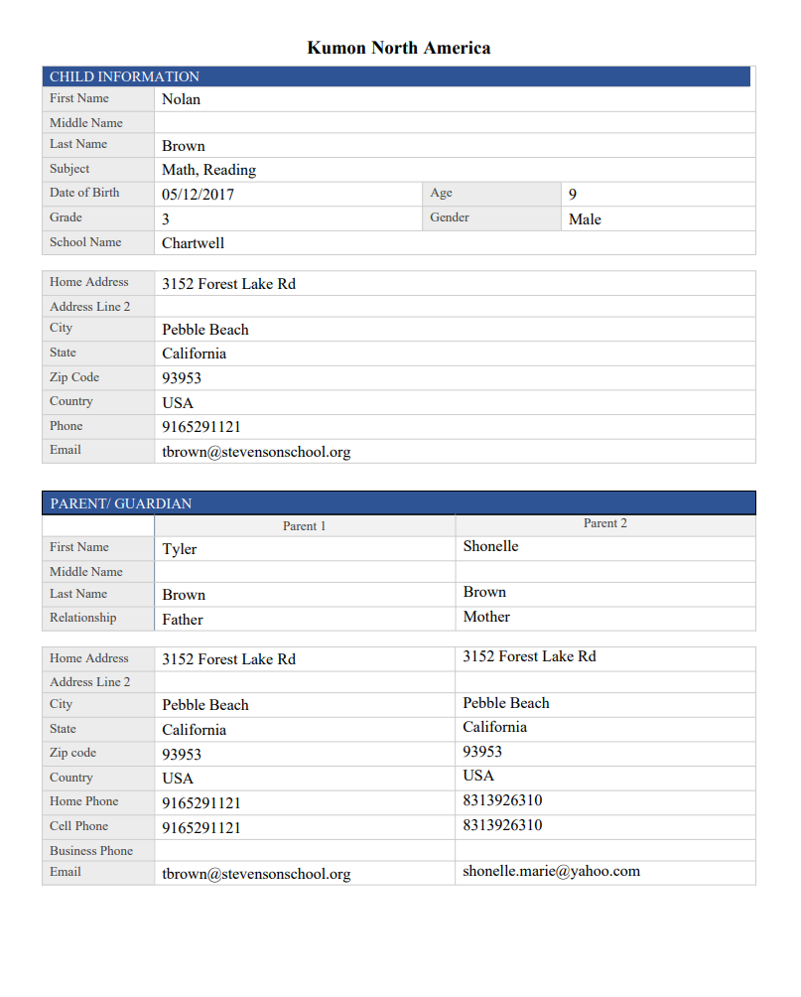
The eEnrollment document
The form downloads in PDF format
Simply upload this document into presently
This is the form filled by the parents themselves.

Slide 4
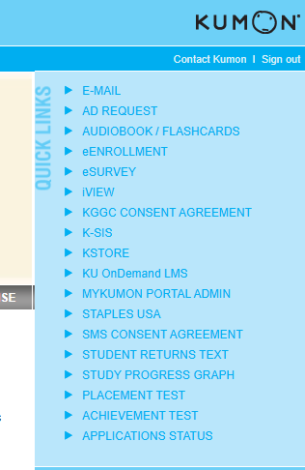
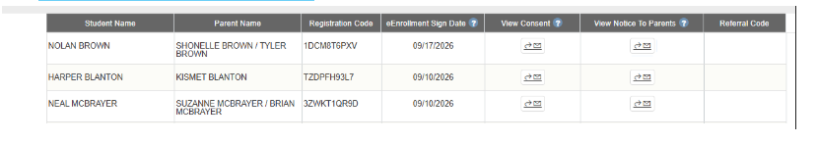
Locating the eEnrollment form
You can find the e-enrollment form
→ iKumon.com (Login)
→far right column click eEnrollment(1)
→under View Notice to parents(2)
→ click arrow with the envelope
→ Download file for each new enrollee.(3)
1
2
3

Slide 5
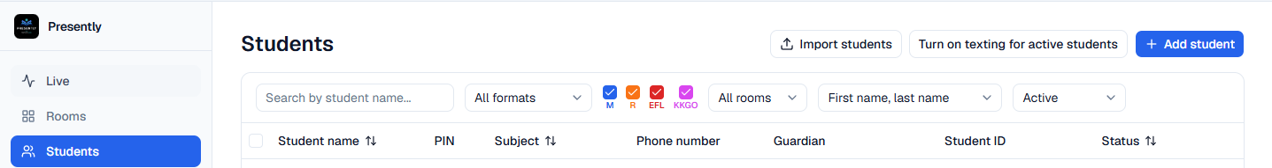
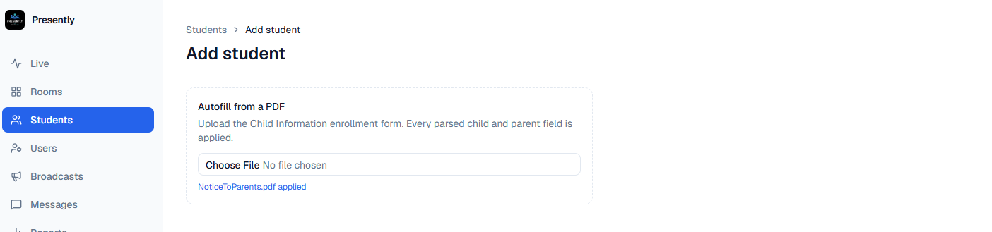

Document Drop into Presently
In Students tab(1) click add student (top right)(2)
2
1
Click on Choose File (3) and drop the eEnrollment form here. Click Add student (4)
3
4

